Slide 1
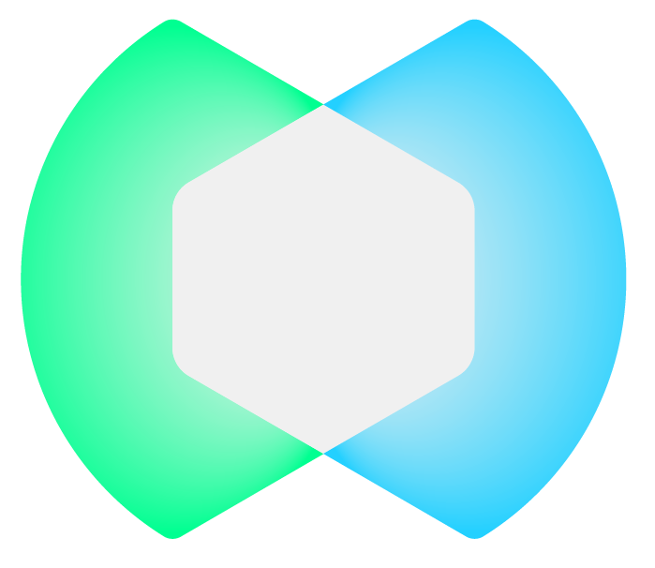
XM Cyber
By Schwarz Group
Hirnschal Ann-Sophie, Huber Jonas,
Tayar Elad, Mizrahi Tomer, Moshe May, Yawetz Reut

Slide 2
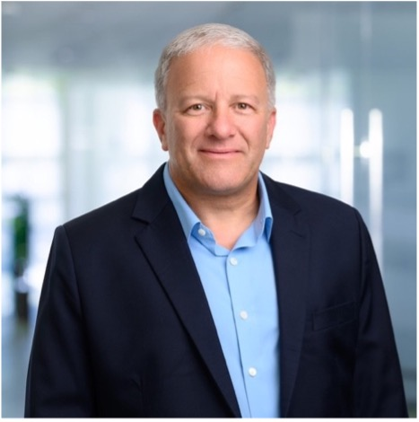
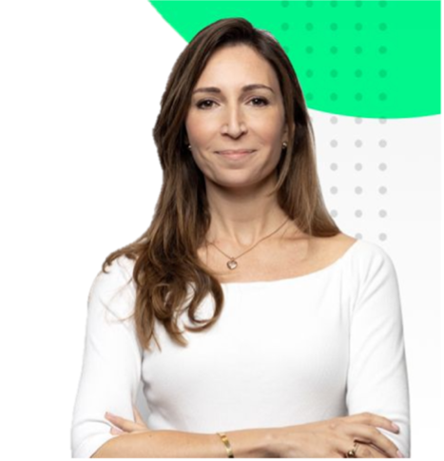
The Interviewees
Zev Barkan
Judith Rudstein
VPO, for two years and three months.
Before, he worked in the Prime Minister's Office and The Israeli Intelligence Community.
Go-to-Market manager, for one year and seven months.
Before, she worked at the National Cyber Directorate in Israel
Notes:
Zev Barkan – VPO:
Worked at the company for about two years and three months.
Before becoming VPO, Mr. Barkan spent over 40 years in the Prime Minister's Office and the Israeli intelligence community.
He brings managerial experience, leads technological and operational divisions including areas such as cyber IT, and was responsible for the division for international cooperation.
He has a bachelor's degree in political science and management from the Open University and a master's degree in political science from Bar Ilan University.
Judith Rudstein – Director, Go-to-Market:
Judith currently serves as Go to Market manager at XM Cyber since September 2022.
Before her current position, she worked at the National Cyber Directorate in Israel within the engagement and operational divisions.
In the past, she received her first degree in international relations and affairs as well as Islam and Middle Eastern studies from the Hebrew University in Jerusalem between 1996 and 1999.
She has a master's degree in political science and government at the Open University from 2008 to 2010. In 2017, she studied positive psychology at Reichman University and at Tel Aviv University - Lahav Executive Education for the program in negotiations.
During 2016 and 2017, she also studied at the Wingate Institute to become a certified yoga instructor.

Slide 3
Introduction to XM Cyber
Founding & Background
Schwarz Group
Expertise & Strategy
Founded in 2016
Origins rooted in High-Tech national security
unique algorithm
Strategic infrastructure deployment
Acquired XM Cyber for $700 million
The fourth largest consumer in the world
“ To manage projects or risks, there should be one person in each field and thus the uncertainty can be eliminated…“
Notes:
Founding & Background:
Founded in 2016, by Noam Erez and Boaz Gorodisky.
Noam and Boaz were previously senior Israeli intelligence officials who transferred their expertise from national security to corporate cybersecurity.
XM Cyber currently has 332 employees:
250 of them are here in Israel,
33 of them are in Germany,
The rest are scattered around the world in the USA, Japan, Singapore, Australia, India, and throughout Europe.
Also, there are two new representatives in Brazil who are starting to look at the latest in the South American market.
Zev claims that there is a vector of growth of 100 employees per year.
Expertise & Strategy:
The founders (Noam and Boaz), leveraged their backgrounds to create a company that specializes in proactive cyber protection, anticipating and mitigating potential breaches before they occur.
The company's unique algorithm provides a response to many companies due to cyber attacks that may occur. The algorithm shows the attacker's eyes from all directions and options and thus prevents the attacks that may take place. In this way, the company succeeds through this algorithm in locating the more exposed computers/systems and thereby succeeds in preventing the attack at a point.
We put an endpoint on every computer approved by the company and every server in the cloud.
What we do is we have an algorithm that sees through the eyes of the attacker.
XM Cyber company finds all the possible attack paths for the computers in the organization by the algorithm as soon as we find a problem, vulnerability, password credentials it can be many of the cyber problems misuse or anything else we mark them and act accordingly.
Schwarz Group:
On November 21, in 2021, Schwarz Group purchased us for 700 million dollars.
Schwarz Group is the fourth largest consumer in the world.
They are scattered in 38 different countries.
Owned by giant companies such as Carrefour, Lidl, and a host of other retail companies.
The Schwarz Group is a privately owned company that is not traded on the stock exchang
The quote:
The quote generally shows the nature of the company, the company advocates team decision-making and if there is uncertainty, the consultation will be together with all the relevant teams to get the best result.

Slide 4
uncertainty and crisis
Flexibility & Resilience
Backup of all data in the cloud
Creative Ways of Coping
Thinking outside the box
Risk Management
Multicultural Workforce
Deployment of teams around the world
Leadership & Understanding
matter of management, leadership, understanding and caring.
Notes:
flexibility and resilience:
Put Their secrets in the cloud:
In terms of risk management, the company performs a nightly backup in the company's cloud.
At first, the question arose among the management about where to store the company's critical data.
The cloud was the most relevant, latest, and best option they could choose both because there is global access at any given time from anywhere in the world and also because a private area may experience damage fire, electricity, missiles, etc., and then there will be nothing left.
That way once everything is backed up in the cloud, everything is saved and organized in the best possible way.
One of the most important risks in managing these times is how flexible you can be. It starts with being in the cloud, which is flexible. The company works with a cloud; the cloud is always there. Employees take from and give to the cloud, so resilience is flexibility with infrastructure.
Creative ways of coping:
It is important to build layers of thinking outside the box to allow ourselves to invest in everyday life to be prepared for difficult times and crises.
For example (Zev): We have one power plant in Israel, and it is down for days. We need to provide the 10 senior managers of the company with the ability to work when we have no electricity in Israel. What do you think we should give the top 10 executives? The solution:
We bought 10 satellite phones; satellite phones do not work on a national network. We give everyone a card that says if you need a CEO, CFO, head of customer success, head of sales to talk, we just say "activate".
A solar panel that allows the sun to recharge the pack.
We have built a team in India and a team in the US that, when we call them, they take over from the cloud and they manage the business with most of our European companies.
Leadership & Understanding:
Building trust and getting people, to do more than they are used to doing in these difficult times. But it is management, leadership, understanding.
It's all a matter of defining the values flexibly, quickly, and correctly.
In the situation we have to deal with in these turbulent times, we communicate even more. I mean, we need the media there more than ever.
There should be a basis of trust based on mutual understanding.
"Knowing both cultures really helps," (Judith said).
There is nothing like hearing the person, hearing how they breathe, looking into their eyes. "Like from earlier, we saw Judith's child enter. It helps to better understand who the person is and what he is dealing with" (Zev said). All these small details are very important, and it doesn't come on WhatsApp.
Multicultural Workforce:
Cultural diversity enriches the company's ability to innovate and adapt to diverse market needs and security challenges.
When dealing with cross-cultural companies, it is very important to get to know each other and really spend time together. Although it is expensive, I believe it is the main key to success.
"I think in Zev's world, where he really works with the whole globe, company events are very important, among them the beginning of the annual sales. At this event, the whole company gathers, especially employees in front of customers, and a huge event takes place. That is why it is very important to see each other face to face from all over the world." (Judith said).

Slide 5
intercultural communication and diversity
1
2
3
sturdiness
sensitivity
understanding
the company has teams all over the world.
The HR team must know, concentrate and be sensitive enough to all the employees
The teams must understand the needs and know the other teams
Notes:
Sturdiness:
The strength is that the company has teams around the world; all of them can compensate in case of need.
"I never know when and what will happen where in the world, but anything, including Covid19, an earthquake, or anything else so that we can compensate each other..." (Zev said).
Sensitivity:
We don't feel cultural problems, but we have to be very sensitive.
The HR team must know when are the holidays of each religion, what is important to respect, what religious needs, and even which of the employees is a vegetarian... They need to concentrate all of this and be sensitive enough to nutrition, religion, holidays, and other needs.
"I think it's just a matter of sensitivity. But in today's world, everyone is used to working with everyone. I don't see it as a big challenge."
Understanding:
An example of cultural change:
Today we are building a new office. What are the two things that every worker around the world does most of the time when they are at work (besides sitting at their desk)?
Makes coffee, and what do you do after you need a lot of coffee? You go to the bathroom.
When the German architects came to design the Israeli office, it was made clear to them the way we treat coffee in these areas, of having open discussions in the coffee area and building it in the right way. Also, everyone goes to the bathroom, and accessibility must be comprehensive and wide for everyone, for a breastfeeding woman, for a disabled person, the right size and the right atmosphere. In the end, the toilets and the coffee kitchenette are two areas that every employee needs because the rest of the day he is on a computer and a desk. Thus, success and the desire to invest come naturally. These architects were very surprised by these unexpected requests and claimed that in their opinion these complexes are not necessary for much investment and that investment should be made elsewhere, but they still insisted on Israel despite the high cost of the space.

Slide 6
intercultural communication and diversity
Human Behavior
Mission
thoughtful and caring
according to the rules
Flexibility
Go by The Rules
Flexible and understanding
Not agree to deviate from the rules
Safe
Unsafe
Security
Security isn’t always
Notes:
The model:
Human behavior vs Mission-Oriented: This model is placed on this graph between mission and human behavior, some of us will be softer, some of us will be tougher.
Human Behavior (how human you want to be): If I am a manager who cares solely about my employee needing help and staying home because they are unwell, I am very human-oriented.
Mission (mission / rules): If I am mission, I might say, "Listen, get yourself together. You can come an hour late, but I need you here.”
Flexibility vs Mission-oriented: One of us might say, "But the company policy... I'm not supposed to." So, I will ask everyone here online, "Has anyone ever driven over the speed limit?" All of us have. So what do we need to sign for? If we have the sign that we don't respect, we are playing between a rule and flexibility.
Flexibility: If I'm human and flexible, you can do what you want on my team. Go home, come, don't work. I love you. Everything's great. It doesn't matter—payment, finance. We'll work it out.
Go by The Rules: If I'm going by the rules and not flexible, I don't care. War or no war. Here's your assignment. Whatever KPIs, I will measure them. Maybe I'll give you a little bit of leverage, but not more. This won't work and that won't work.
Safe vs Unsafe: All of us have different areas of thinking.
Safe – Security: "What is safe?" "Come to the office." - "I'm scared there might be rockets. I don't want to come to the office for two months”. What do you mean? everyone comes..” - It's not safe.”
Unsafe - security isn't always: It's non-secure to the other, and you need to relate in these times what is or isn't in your point of view and how you reflect it.
So, in security, flexibility, human mission in all of these unknown times, we need to understand what we think, and we need people to help us think otherwise.
And then we can make a decision from two different points of view.
The summarize of the model:
"When you take these three lines, each one of us is at three different points". On this graph, we can understand that none of us are the same.
When you connect the snake between the dots and the ladder is to go up and down, has to know where they are and then how you deal in a generic way in unstable or unknown situations.
You need to understand where you are and to complement yourself with the staff, with people who are different from you.
If I'm very human, I would like my deputy to be mission-oriented.
If I'm mission-oriented, I want my deputy to be human and tell me, "You're killing them. Let them go. Send them home. Tell them not to come." Tomorrow, if both of us say "mission, mission," we're going to harm the team.

Slide 7
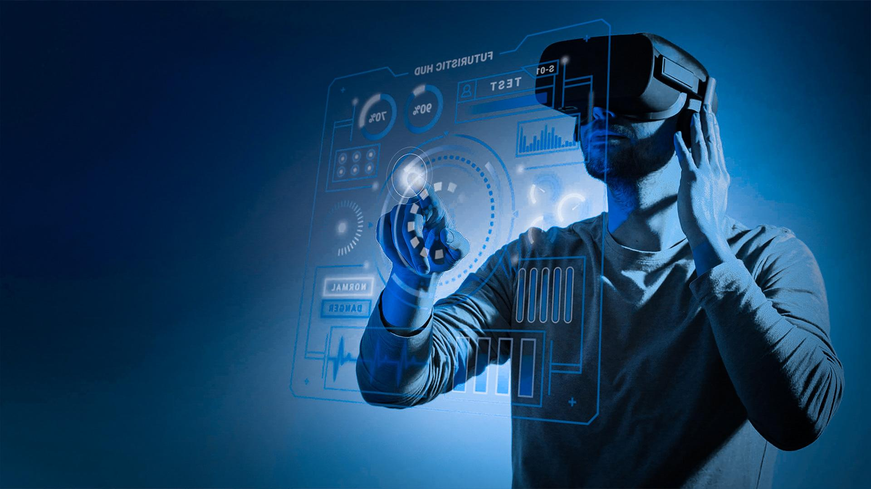
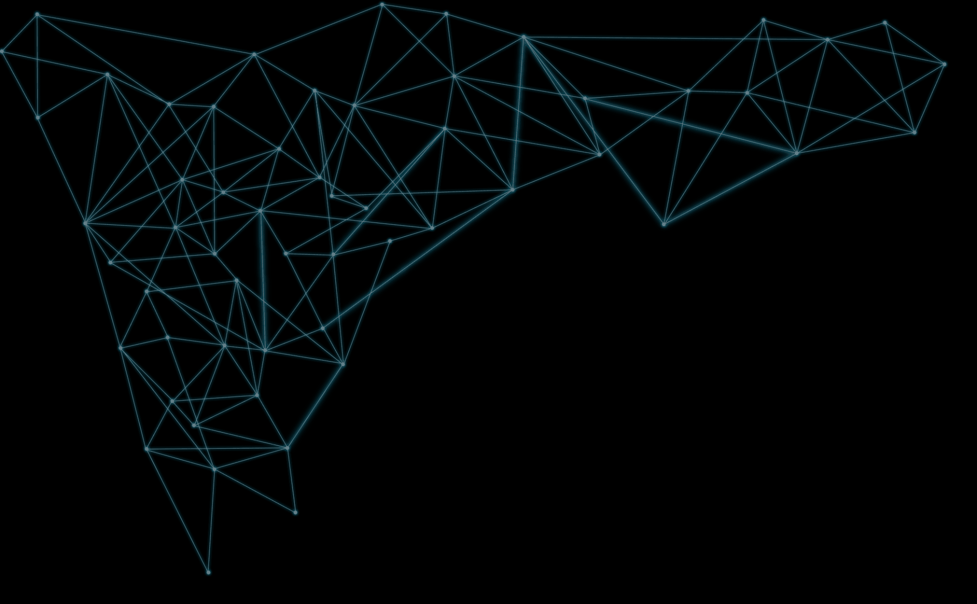
Conclusion & Self-impression
What surprised us?
What was easy / difficult?
What did we enjoy?
Notes:
Conclusion:
We have people from technology, and people from the field.
We sit in the same room to make a decision.
We want two different points of view to understand what we are deciding, what risk we are taking, and how we are treating our employees, which is the most important factor in the company.

